Slide 1
HYBRIS: web services week 9
Task 9.2 - (Web services):
Task: Activate Web Services to perform CRUD operations with user entity.

Slide 2
Activate web services requires two things to do: - Add the ‘platformservices’ extension to the localextensions.xml file. <extension name="platformwebservices"/> - Run an update in HAC.
Implementation details

Slide 3
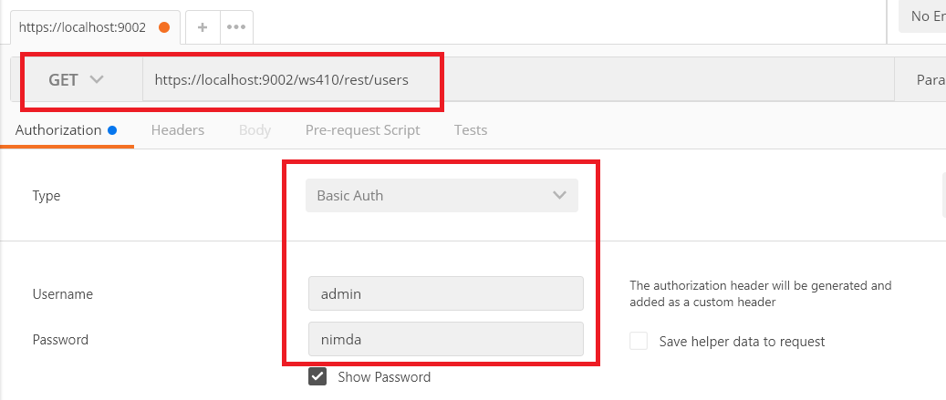
I used Postman (Ghrome extension) to send a GET request to check if the REST API got activated. I had to go with basic authentication.
Verification

Slide 4
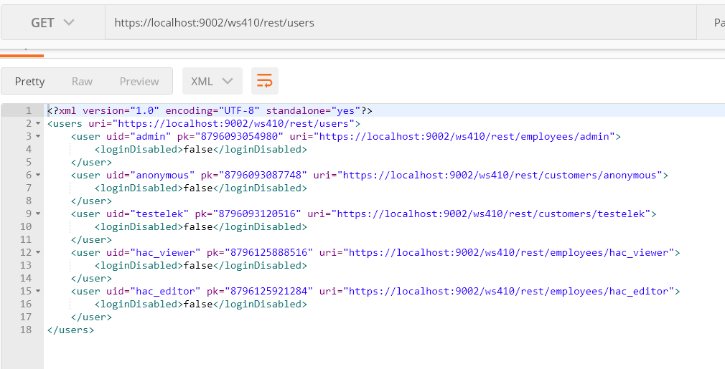
I could see the list of the users in the response in XML format.
Verification

